Slide 1
Order Book Liquidity on Crypto Exchanges
Martin Angerer – University of Liechtenstein
Marius Gramlich – University of Liechtenstein
Michael Hanke – University of Liechtenstein
Presented by Marius Gramlich
3rd Crypto Asset Lab Conference
05.11.2021

Slide 2
Introduction
In recent years, cryptocurrencies have gained in importance in various ways
An increasing number of investors have come to acknowledge cryptocurrencies as a separate asset class
This is supported by the rise of altcoins, several of which outperformed Bitcoin in recent years and broadened the investment opportunities within this new asset class.
These developments have spurred new research on cryptocurrencies
This is observed by a rapidly growing number of papers on topics in this area

Slide 3
Motivation
However, most of the literature still focuses on Bitcoin and on data derived from price series, such as returns or volatilities
Price data are widely available, order book data are harder to come by
We incorporate altcoins and to derive our results from order book data
Liquidity, while of high importance for cryptocurrency investors, has received less attention
No particular concept or aspect of liquidity is broadly accepted in the literature
We use liquidity measures which are applicable to all trading pairs and allows us to compare results across exchanges and currencies
Relevance for academia: liquidity is an important indicator of (and requirement for) market efficiency
Relevance for investors: liquidity impacts transaction costs, which in turn impact the investor’s profit/loss from trading

Slide 4
Data (1/2) – Raw Data & Data Processing
Order book data from the exchanges Binance, Kraken, Huobi, and OKEx provided by Cryptotick
Time frame: Jan. 1, 2019 until Sept. 30, 2019 (273 days)
24/7 limit order book data
We created 5-minute order book snapshots, 288 order book snapshots per day
Filters to ensure data quality
Crypto reported as quantity is labeled as Target Currency
Crypto or fiat currency reported as price is labeled as Base Currency
Each combination of a target currency and base currency yields a Currency Pair or Trading Pair

Slide 5
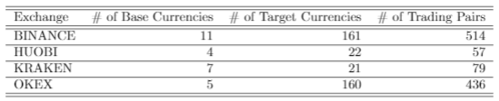
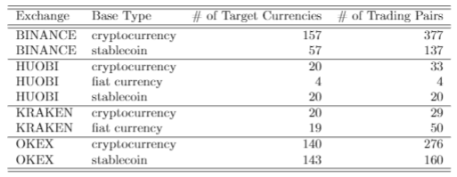

Data (2/2) – Descriptive Statistics
Modest number of base currencies
Strong variation in target currencies and trading pairs
Distinguish between three base currency types: fiat currencies, stable coins and other cryptocurrencies
The exchanges pursue different objectives in their services
71% of the target currencies and 82% of the currency pairs are only traded on one exchanges
Necessity to apply liquidity measures which are comparable among all currency pairs to understand the overall crypto market better

Slide 6
Methodology (1/3)
We choose liquidity measures which can be applied to all trading pairs and make them comparable regardless of their target and base currency
Many liquidity measures keep the units of either the target or base currency, e.g. trading volume
We disregard transaction data and solely derive the liquidity measures from the order books
We generate daily values for the liquidity measures by taking the average of our studied measures for the day
We compare the results based on the exchanges and the base currency types
Notes:
Since trading is possible 24/7 and we work with data at five minute intervals, the resultingliquidity measures at this frequency would be quite noisy. For this reason, we generate daily valuesfor the liquidity measures by taking the average of our studied measures for the day. The resultingvalues are much less noisy than, e.g., liquidity measures calculated from order book snapshots takenat a daily frequency.

Slide 7
Methodology (2/3) – Order Book Slippage (Intraday)
We measure slippage by the number of order book levels the mid price moves from one such snapshot to the next
We measure two variables, the average slippage and the maximum slippage of the day
This slippage measure accounts for two liquidity-consuming factors, cancelled orders and trades, but trades are expected to be the main driver
The big advantage of this measure is that it captures the liquidity dynamics of the order books without putting too much emphasis on the exact numbers
It allows to evaluate if an order book can supply sufficient liquidity for the demand of traders
Notes:
Average slippage: short-term fluctuations and can beinterpreted as a measure of the average level of slippage for a currency pair on a given trading day
Maximum slippage: which can be interpreted as the worst-caseslippage recorded for a currency pair on a given trading day.
The difference between the two is asimple measure of slippage risk

Slide 8




Methodology (3/3) – Order Book Spread and Imbalance
Spread Measures
Gomber et al. (2015) interpret the relative spread as a liquidity premium which has to be paid to execute an order immediately
Cao et al. (2009) provides evidence that levels deeper in the order book are less prone to noise and carry more relevant information about the liquidity of limit order books.
Imbalance Measures
Biais et al. (1995) find evidence that a higher order imbalance is linked to higher trading costs.
Bonart and Gould (2017) argue that order book imbalance is a strong predictor of order flow

Slide 9
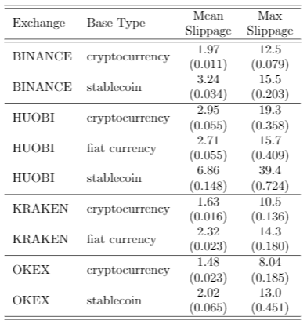


Results (1/3): Slippage, Spreads & Imbalance
Contradicting results for liquidity measures (slippage vs spread & imbalance)
Indication that slippage is endogenous

Slide 10
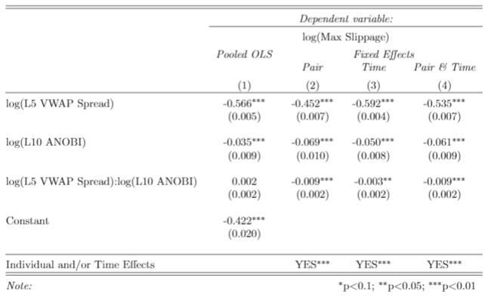
Results (2/3): Regressions for Slippage I
Pooled OLS and 3 Fixed Effect models
Also include interaction term to account for collinearity of spread and imbalance
Significant trading pair individual and time fixed effects
Economically, stronger effect of spread than of imbalance
Strong evidence that slippage can be explained by spread and imbalance
Large trades are timed for high liquidity phases
Similar results for other combinations of spread and imbalance levels

Slide 11
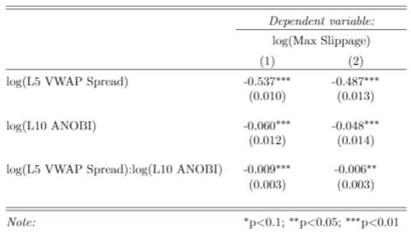
Results (3/3): Regressions for Slippage II
Panel (1): negative imbalance
Panel (2): positive imbalance
Stronger effects of spreads and imbalances for negative imbalanced order books
higher depth on the bid side contributes more strongly to lower slippage than the other way around
This could explain price drawdowns and panic selling behavior of traders if they observe a decline in selling opportunities (lower bid volume) or an increase in offers to sell (higher ask volume)
Traders are accepting higher spreads to sell their currencies than they are to buy new ones

Slide 12
Concluding Remarks
Using standardized liquidity measures is necessary to capture the special features of crypto markets.
Contradicting results for liquidity (slippage vs spread & imbalance) indicates that slippage is endogenous
Slippage can be explained by spread and imbalance, large orders causing slippage are timed in phases with high liquidity in terms of small spreads and balanced order books
Traders are accepting higher spreads to sell their currencies than they are to buy new ones

Slide 13
Thank you for your attention.

Slide 14
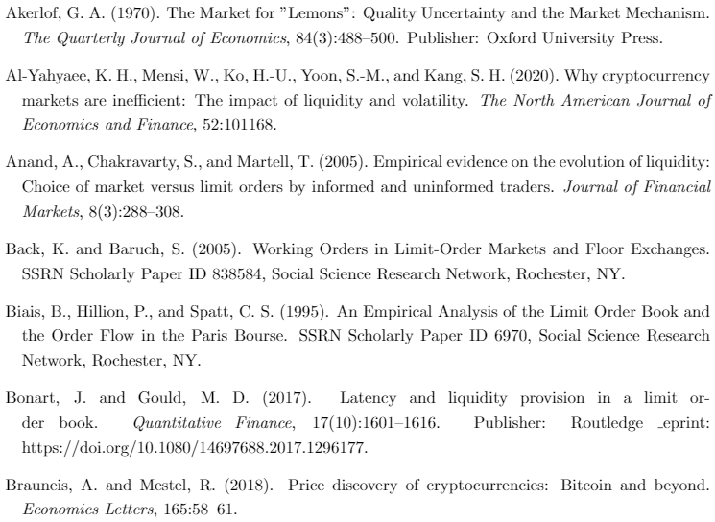
Reference List (1/5)

Slide 15
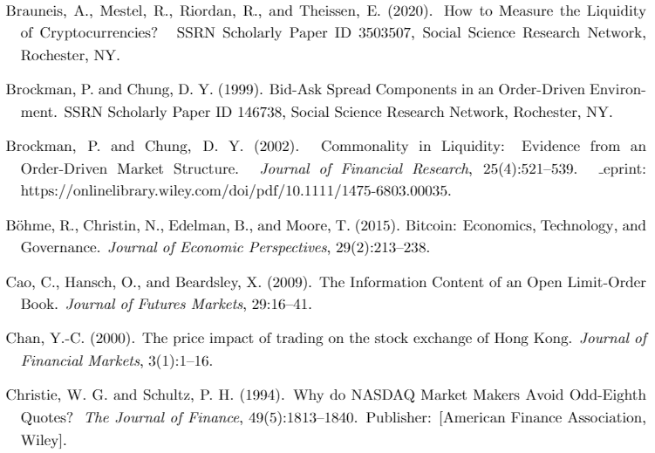
Reference List (2/5)

Slide 16
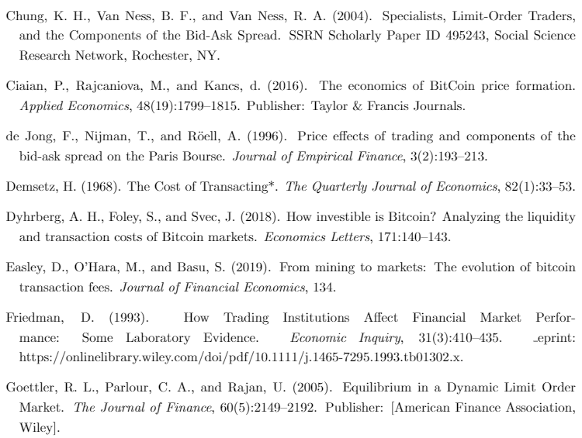
Reference List (3/5)

Slide 17
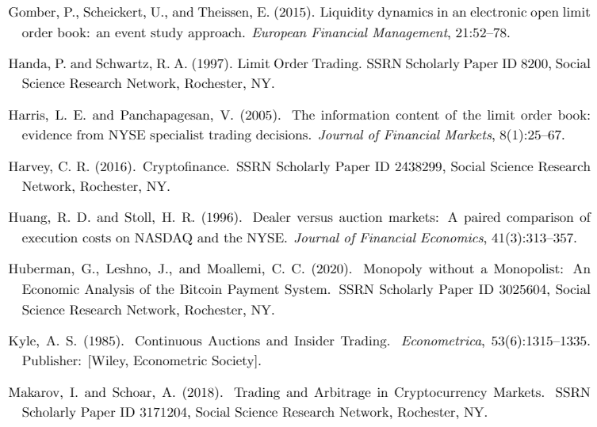
Reference List (4/5)

Slide 18
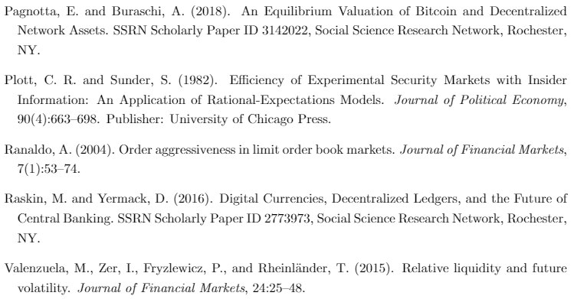
Reference List (5/5)

